Slide 1
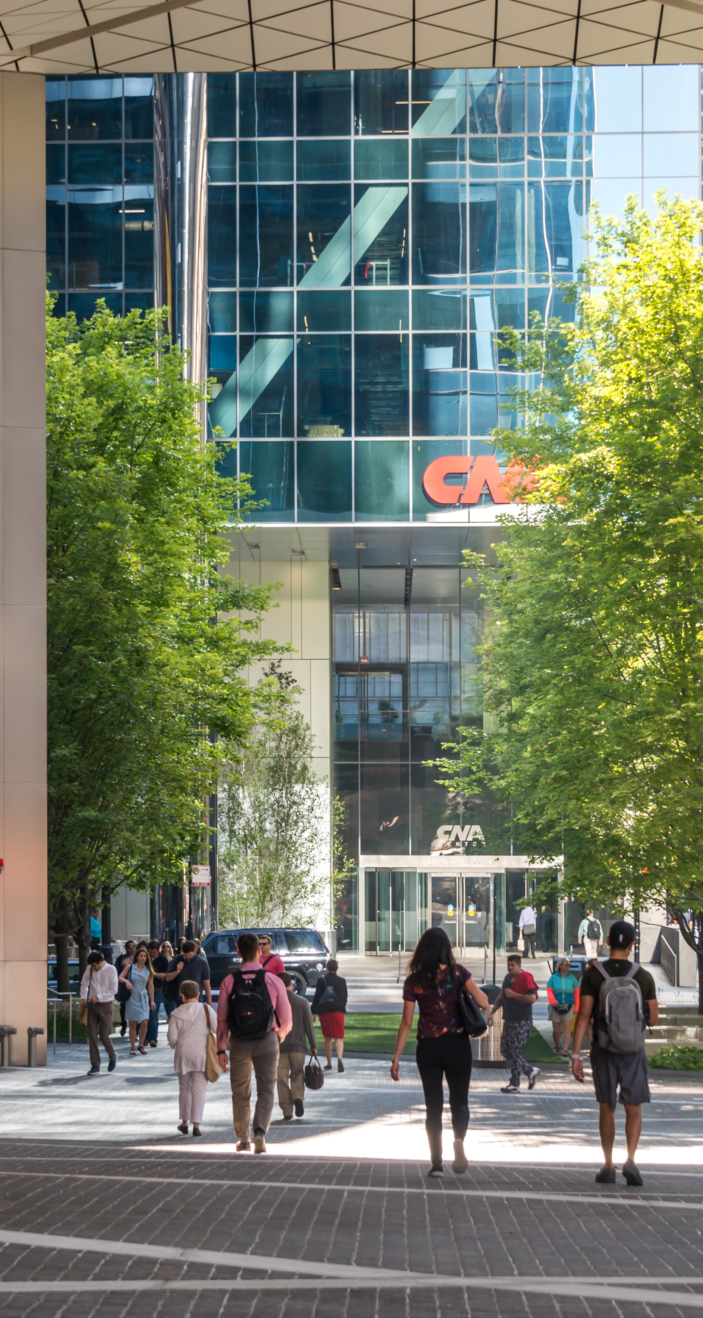

2023 U.S. Public Policy Engagement and Political Contributions

Slide 2
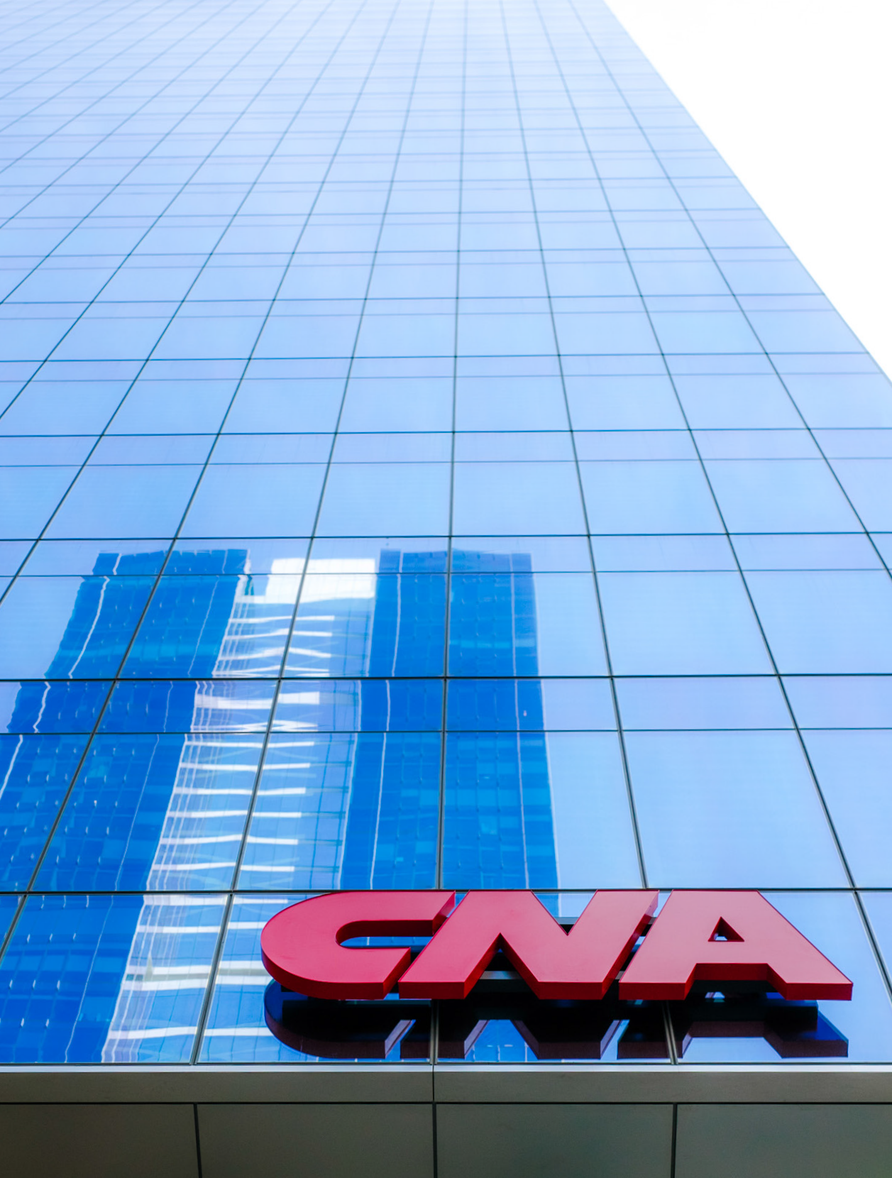
CorporateSuccess Playbook| 2021 U.S.| MarketingPublic PolicyMaterialsEngagement and Political Contributions ²
Corporate | 2023 U.S. Public Policy Engagement and Political Contributions
2
Public Policy Engagement
As CNA operates in a highly regulated industry, we monitor and engage in public policy activities to advocate for state and federal laws and regulations that align with our core business strategies and values.
We believe it is vital for CNA to monitor and engage in the public policy making process to maintain effective business operations and to promote positions that are important to our employees, policyholders and shareholders. We engage responsibly and comply with applicable state and federal laws.
Our Government Relations team leads our public policy engagement activities and partners with our business leaders to define our advocacy priorities.
Once our legislative and regulatory goals are defined, we advocate for those goals through direct engagement with public officials, and through collaboration with industry and business associations. A list of all industry associations where CNA’s membership payments exceeded $25,000 in 2023 is included in this report, along with the amount of those payments used for lobbying activities.

Slide 3
Corporate | 2023 U.S. Public Policy Engagement and Political Contributions
3
Federal and State Political Contributions
We also participate in the political action process by contributing to candidates who support our positions on key industry issues.
As a corporation, CNA cannot make contributions to candidates for federal office, national political parties or federal PACs. Therefore, any such contributions are made solely through CNA Citizens for Good Government, a political action committee (CNA PAC), which is funded through the voluntary support of eligible CNA employees. CNA PAC’s activities are overseen by a board of directors comprised of CNA business leaders. CNA PAC’s 2023 contributions are disclosed on the following pages.
In states where it is allowed by law, we make corporate contributions to state and local candidates, political parties, trade association political action committees and ballot initiatives. Our 2023 state-level corporate contributions are disclosed on the following pages. Our Government Relations team reviews all employee-funded political action committee contributions and all corporate contributions to direct them to candidates who are likely to support the issues important to CNA and the insurance industry.

Slide 4
Corporate | 2023 U.S. Public Policy Engagement and Political Contributions
4
2023 Contributions (CNA PAC)
Name | Candidate | Office Sought - District Name | Office Sought - State | Amount
American Property Casualty Insurance Association Political Action Committee |  |  |  | $5,000
Andy Barr for Congress, Inc. | Rep. Andy H. Barr, IV | FH – 06 | KY | $2,500
Building America’s Republican Representation PAC | Rep. Andy H. Barr, IV | FH – 06 | KY | $2,500
Davidson for Congress | Rep. Warren Davidson | FH – 08 | OH | $1,000
DiSanto For Senate | Sen. John M. DiSanto | SS – 15 | PA | $1,000
Friends of Joe Pittman | Sen. Joe Pittman | SS – 41 | PA | $1,000
Friends of Kim Ward | Sen. Kim L. Ward | SS – 39 | PA | $1,000
Friends of Sharif Street | Sen. Sharif T. Street | SS – 3 | PA | $1,000
Garbarino For Congress | Rep. Andrew Garbarino | FH – 02 | NY | $2,500
LaHood For Congress | Rep. Darin LaHood | FH – 16 | IL | $5,000
Mike Bost For Congress Committee | Rep. Mike Bost | FH – 12 | IL | $2,000
Peters for Michigan | Sen. Gary Peters | FS | MI | $1,000
Robin Kelly For Congress | Rep. Robin Lynne Kelly | FH – 02 | IL | $3,500
Schneider For Congress | Rep. Bradley Schneider | FH – 10 | IL | $1,000
Texans for Joan Huffman | Sen. Joan Huffman | SS – 17 | TX | $1,000
The Surety & Fidelity Association of America Political Action Committee |  |  |  | $5,000
Tomorrow is Meaningful PAC | Sen. Timothy Eugene Scott | FS | SC | $1,000
 | Total Amount Paid $37,000

Slide 5
Corporate | 2023 U.S. Public Policy Engagement and Political Contributions
5
2023 Contributions (CNA Corporate)
California
Alvarado Gil for Senate 2026 | $3,000
American Property Casualty Insurance Association California Political Action Committee | $9,100
Angelique Ashby for Senate 2026 | $4,500
Anna Caballero for State Treasurer 2026 | $1,500
Avelino Valencia for State Assembly 2024 | $1,500
Blanca Pachero for Assembly 2024 | $1,500
Brian Jones for Lt. Governor | $1,500
Cottie Petrie Norris for Assembly 2024 | $1,500
David Alvarez for Assembly 2024 | $1,500
Efren Martinez for Assembly 2024 | $1,500
Essayli for Assembly 2024 | $1,000
FAIRPAC sponsored by the Civil Justice Association of California | $9,100
Gallagher for Assembly 2024 | $1,500
Gipson for Assembly 2024 | $1,500
Jim Wood for Assembly 2024 | $1,500
Josh Lowenthal for Assembly 2024 | $1,500
Juan Alanis for Assembly 2024 | $1,500
Juan Carillo for Assembly 2024 | $1,000
Lisa Calderon for Assembly 2024 | $2,500
Lori Wilson for Assembly 2024 | $1,500
Marc Berman for Assembly 2024 | $1,500
Papan for Assembly 2024 | $1,500
Re-Elect Rick Chavez Zbur for Assembly 2024 | $1,000
Rodriguez for Assembly 2024 | $1,500
Roger Niello for Senate 2026 | $1,500
Sabrina Cervantes for Senate 2024 | $1,500
Sanchez for Assembly 2024 | $1,000
Soria for Assembly 2024 | $2,500
Stephanie Nguyen for Assembly 2024 | $1,500
Susan Rubio for Senate 2026 | $1,500
Suzette Martinez Valladares for Senate 2024 | $1,500
Tim Grayson for Assembly 2024 | $1,500
Wilk for Lt Governor 2026 | $1,500

Slide 6
Corporate | 2023 U.S. Public Policy Engagement and Political Contributions
5
2023 Contributions (CNA Corporate)
Colorado
New Day Colorado Fund | $5,000
Senate Majority Fund | $5,000
Florida
Building On Your Dreams | $5,000
Citizens for Building Florida’s Future | $2,000
Colleen Burton Campaign | $1,000
Conservatives for Principled Leadership | $5,000
Friends of Tommy Gregory | $2,000
Honest Leadership | $5,000
Jason Shoaf Campaign | $1,000
Living Life with Purpose | $5,000
Philip Wayne Griffitts Campaign | $1,000
Georgia
Georgia House Republican Trust Inc. | $1,000
Illinois
Emanuel Christopher Welch | $2,500
Friends of Don Harmon for State Senate | $2,500
Illinois Manufacturers Association | $5,000
Jones for State Representative | $5,000
Indiana
Insurance Political Action Committee | $8,000
Missouri
Missouri Insurance Coalition | $1,500
New Mexico
Doreen for State Rep. #52 | $500
Friends for Christine | $500
New York
NYS Democratic Asesmbly Campaign Committee | $1,000
NYS Democratic Senate Campaign Committee | $1,000

Slide 7
Corporate | 2023 U.S. Public Policy Engagement and Political Contributions
5
2023 Contributions (CNA Corporate)
South Carolina
SC Republican House Caucus | $1,000
South Carolina State Republican Caucus | $1,000
Texas
Associated Republicans of Texas Campaign Fund | $2,500
Washington
Enterprise Washington | $5,000
Mark Mullet for Governor | $1,000
Nationwide Organizations
Republican State Leadership Committee | $102,500
 | Total Amount Paid $247,700

Slide 8
Corporate | 2023 U.S. Public Policy Engagement and Political Contributions
5
2023 Trade Associations
The American Property Casualty Insurance Association | $366,826
American Tort Reform Association | $17,500
Associated Industries of Florida | $15,750
Civil Justice Association of California | $15,400
Florida Insurance Council Inc. | $12,800
Illinois Insurance Association | $28,700
Illinois Manufacturers Association | $3,575
Institute for Legal Reform | $275,000
Insurance Federation of Pennsylvania Inc. | $5,883
Insurance Institute of Indiana | $2,576
National Insurance Crime Bureau | $4,587
New Jersey Civil Justice Reform Institute | $13,500
Out & Equal | $39,990
The Surety & Fidelity Association of America | $9,640
Texans for Lawsuit Reform | $20,000
The Lawsuit Reform Alliance of New York | $1,750
Wisconsin Insurance Alliance | $8,750
 | Total Amount Paid $866,152

